Slide 1

Neural Network Models for Object Recognition
Group 1: Presentation

Slide 2
Contents
Neural Network Design
Aim
Data split
Preprocessing - Encoding to_category for the 10 classes
Model design
Overfitting alarm
Dropout technique
Model evaluation - kernel size
Model evaluation - No of kernels & Early Stopping
Epochs used
Model evaluation- no.of convolution layers
Discussion
Conclusion

Slide 3
Introduction
Object recognition - deep learning application
Machines perceive like humans - drive cars, read and comprehend documents
Convolution neural network (CNN) - object detection through feature learning
Artificial neural network (ANN) - Classify object

Slide 4
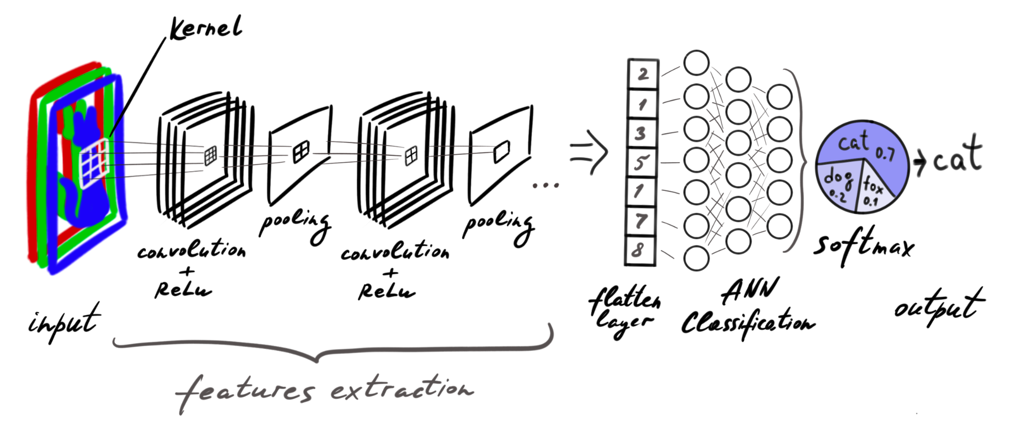
Neural Network Design
Two main steps: Feature learning and classification

Slide 5
Aim
To build a neural network for object recognition
To evaluate the built model
Image data: Open source CIFAR-10- Object Recognition image dataset, hosted in Kaggle. It consists of 60000 32x32 colour images in 10 classes, with 6000 images per class. 10 classes: airplane, automobile, bird, cat, dear, dog, frog, horse, ship, truck
Python libraries used: numpy, tensorflow, keras, pandas, seaborn,

Slide 6
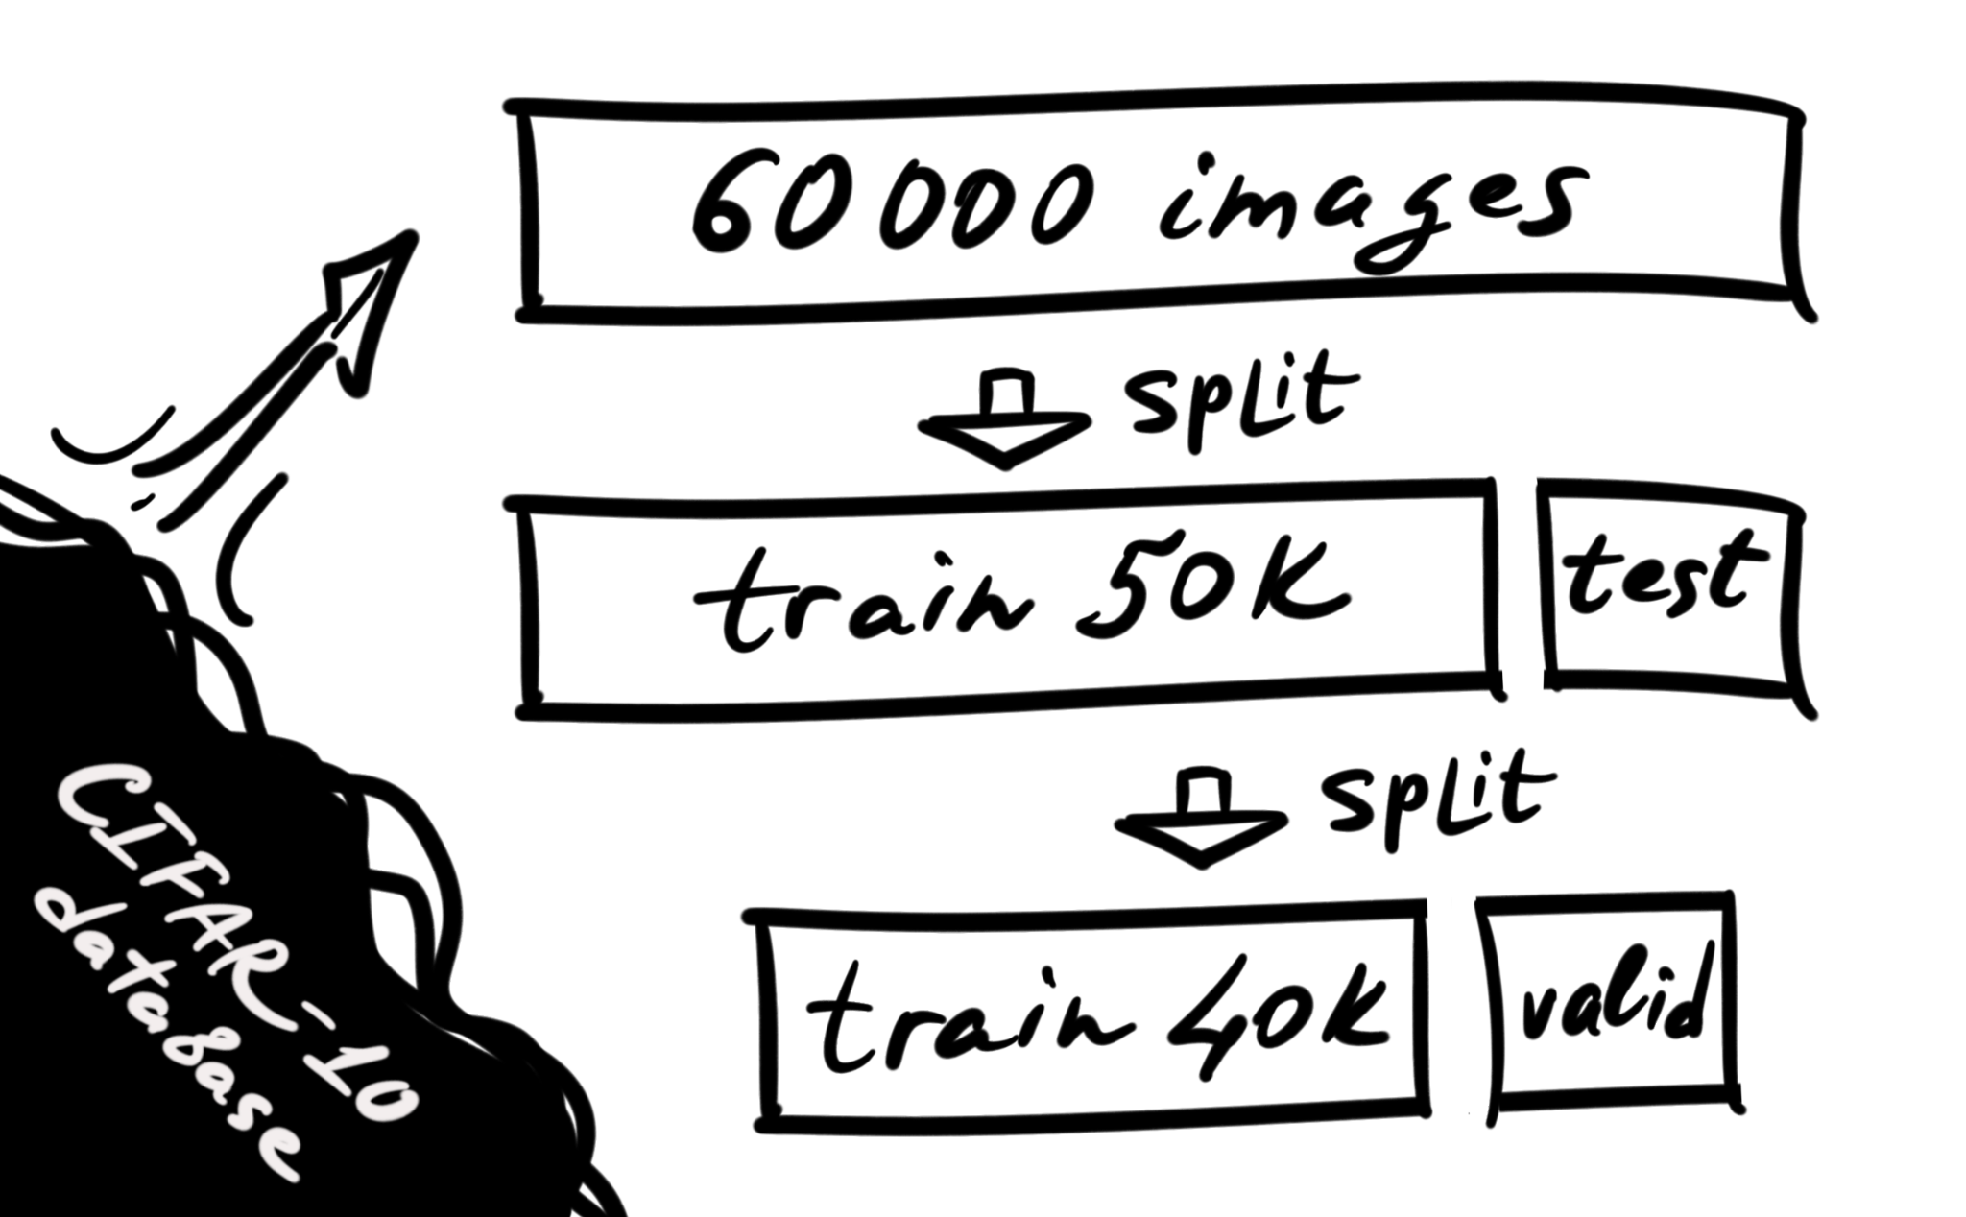
Data split
The CIFAR-10 dataset
has 50000 training images
and 10000 test images.
10000 images out of
50000 training images
were used for validation.
Training:Validation:Testing = 40000:10000:10000
Training data: Model trained the data
Validation data: Model fine-tuning, help to improve model performance
Testing data: Provides measure of accuracy of built model
The CIFAR-10 dataset
has 50000 training images
and 10000 test images.
10000 images out of 50000 training images
were used for validation.
Training:Validation:Testing = 40000:10000:10000

Slide 7
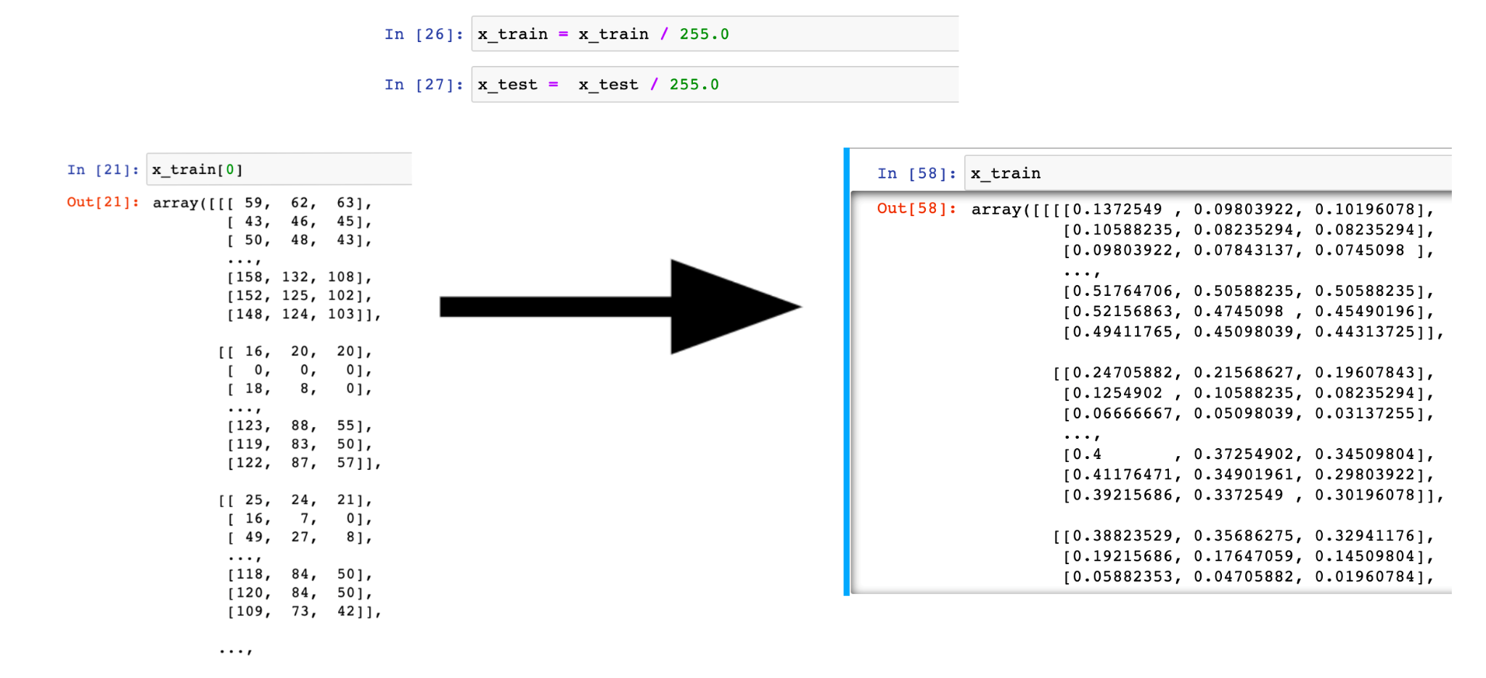
Preprocessing - Normalising the data
With Numpy library providing normalisation for every pixel in both training and testing datasets.
From 0 to 255 for each of three channels (RGB) it comes to a range between 0 and 1.

Slide 8
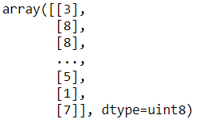
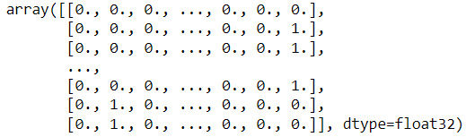
Preprocessing - Encoding to_category for the 10 classes

Slide 9
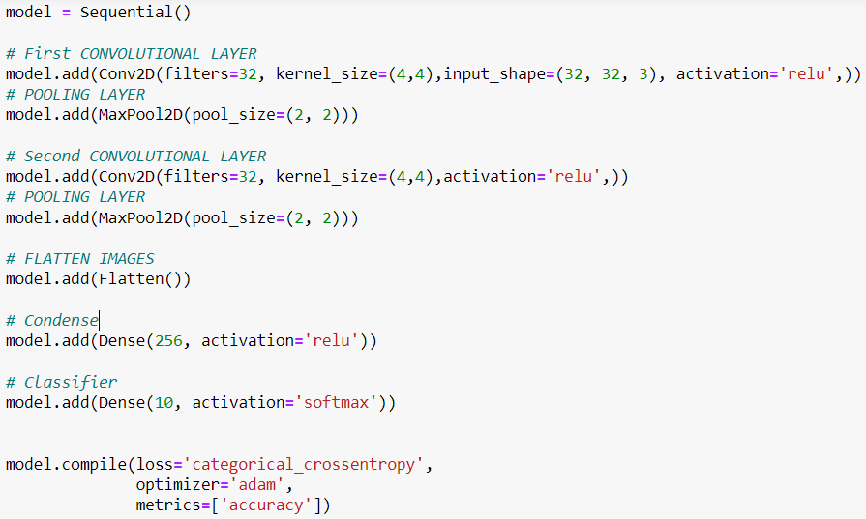
Model design
Schematic image for the neural network:
The same written in code:

Slide 10
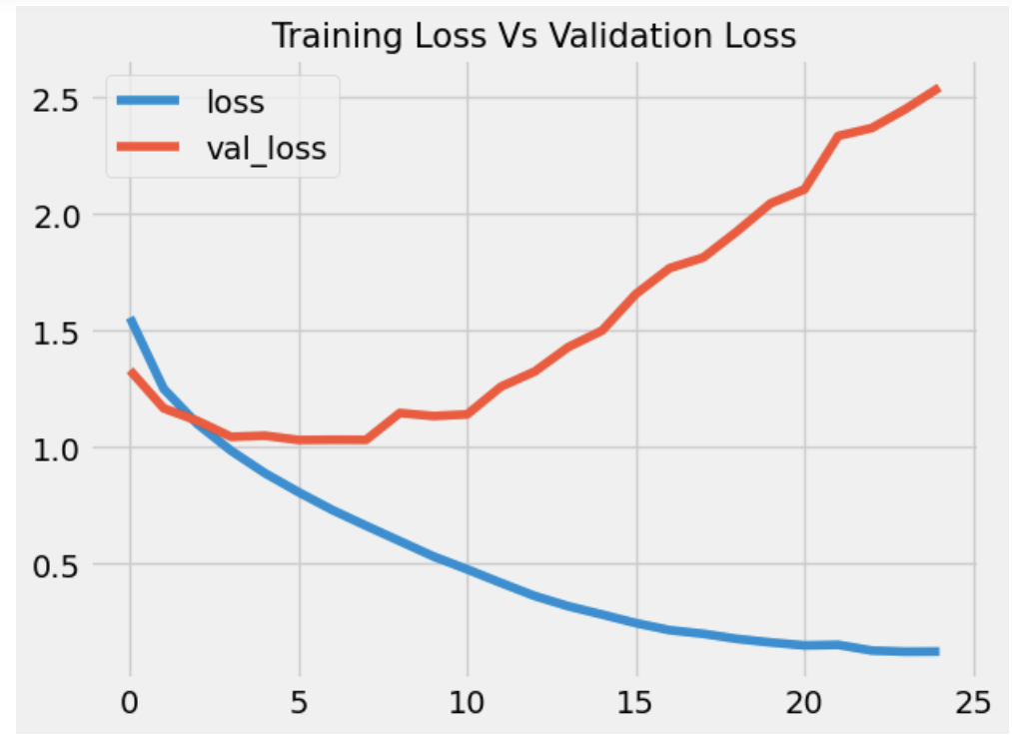
Overfitting alarm
It starts well, but after a few first iterations the loss in validation set increases.
The model shows an overfitting relationship with a very low training loss but relatively high validation loss.
Overfitted neural networks are not good at generalizing. (Doon et al., 2018)

Slide 11
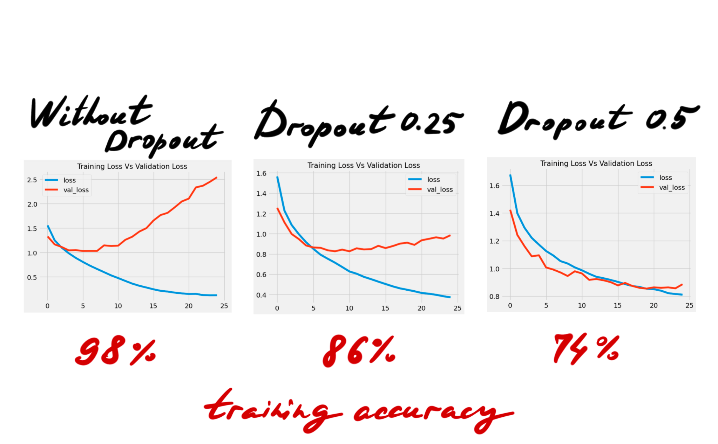
Dropout technique
Using the Dropout technique to manage with overfitting.
It randomly drops units from the network with some probability during training. (Srivastava et al., 2014)
However on the long distance of many epochs Dropout decreases the training accuracy.

Slide 12
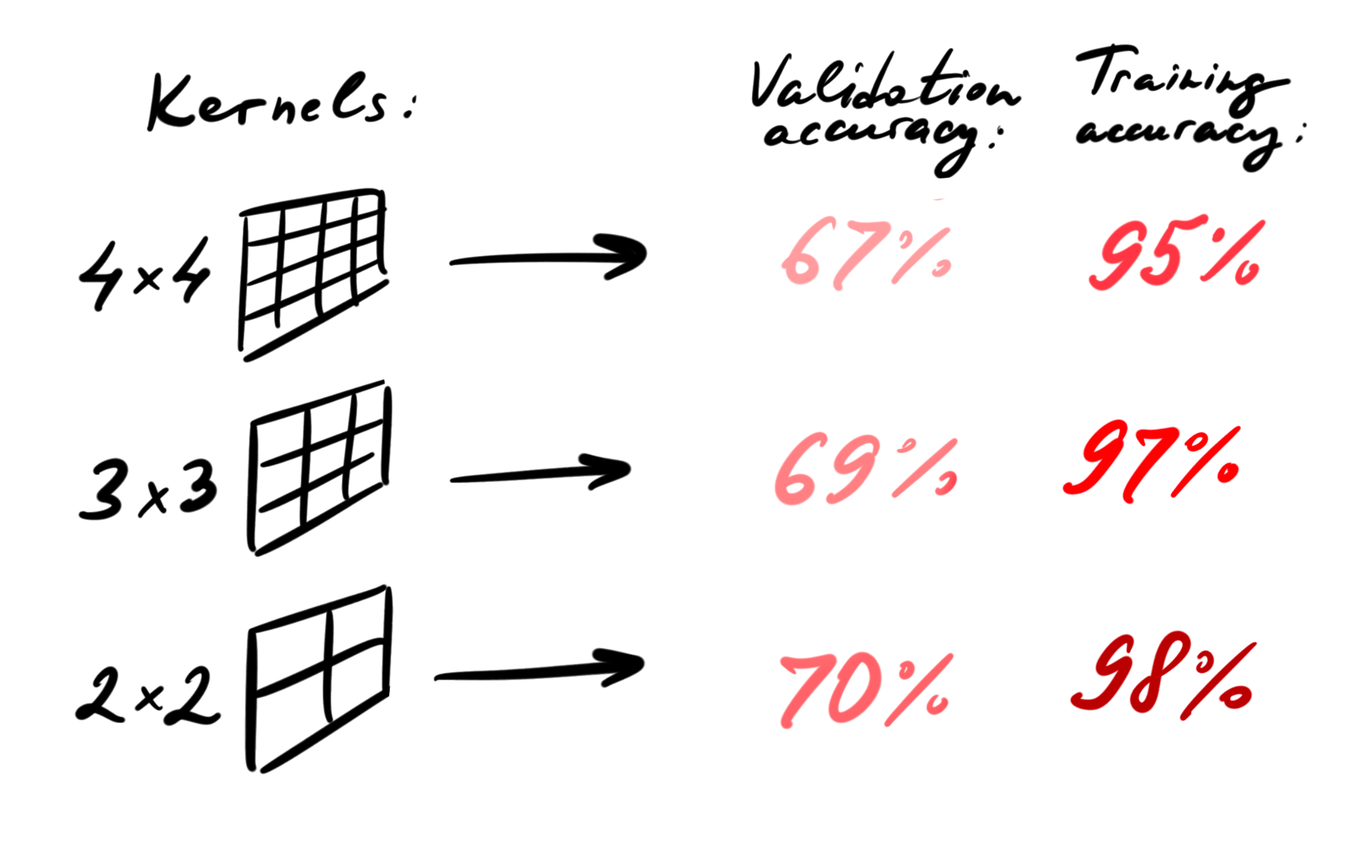
Model evaluation - kernel size
A little correlation of a kernel size and validation/training accuracy of the model.
A relatively small size of the kernel helps to find more details in the picture. The bigger kernel seize could generalise better.
(Cortes et al., 2010)

Slide 13
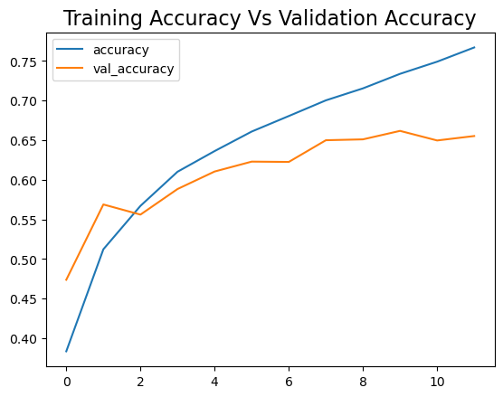
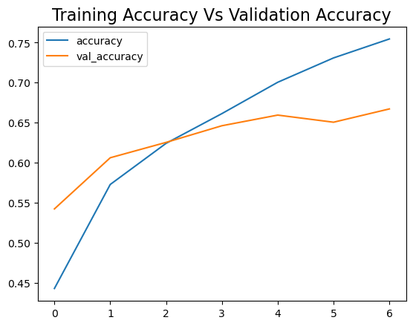
Model evaluation - No of kernels & Early Stopping
Kernels 32 - Training accuracy 75.5%
Kernels 64 - Training accuracy 76.7%
Another way to avoid overfitting

Slide 14
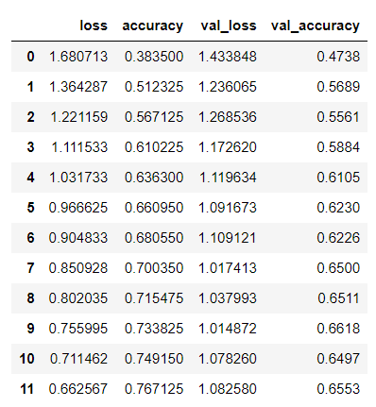
Epochs used
Our model used 12 epochs - optimal
Used early stopping, patience 2
Too many epochs - overfitting problem

Slide 15
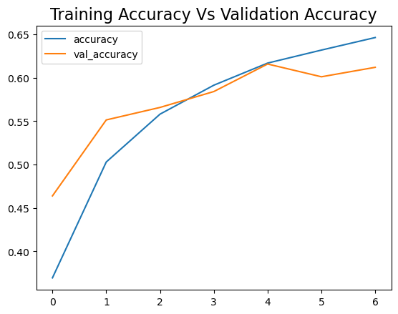
Model evaluation- no.of convolution layers
Adding one more convolution layer 2+1
Validation accuracy more closer to training accuracy

Slide 16
Discussion
Key findings:
• The smaller kernel size increases the accuracy for the training model
• Double number of kernels provides better accuracy (+1.2%)
• Dropout helps to manage overfitting, but decreases further accuracy
• One more Convolutional + ReLU layer increases accuracy
• Early stopping trick prevents from overfitting on the long distance

Slide 17
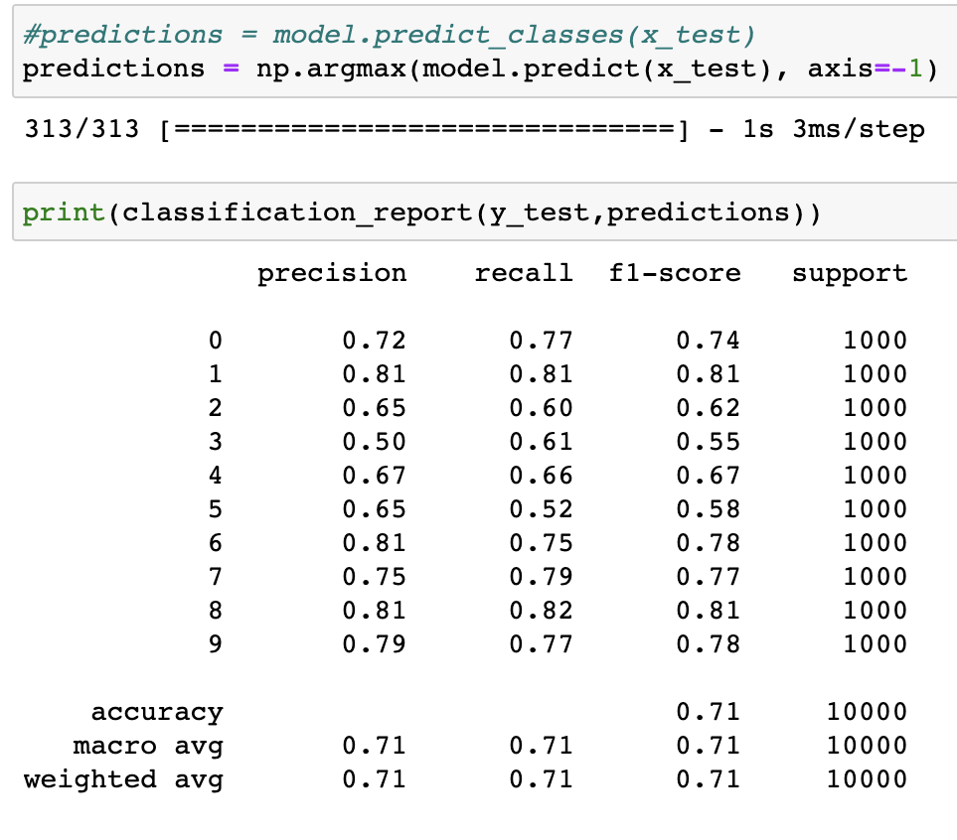
Conclusion
The CIFAR-10 data set is divided into a training and a test set, but does not come with a validation set by default.
We created a validation set, then we trained the model on the training set, and tested on the validation set to see if it is a good fit.
In the end the testing set was used to calculate accuracy: about 71%.

Slide 18
References
The CIFAR-10 dataset. Available at: https://www.cs.toronto.edu/~kriz/cifar.html [Accessed 1 Dec 2022]
Krizhevsky, A. & Hinton, G. (2009) Learning multiple layers of features from tiny images.
Recht, B., Roelofs, R., Schmidt, L. and Shankar, V. (2018) Do cifar-10 classifiers generalize to cifar-10?. arXiv preprint arXiv:1806.00451.
Doon, R., Rawat, T.K. and Gautam, S. (2018). Cifar-10 classification using deep convolutional neural network. In 2018 IEEE Punecon (pp. 1-5). IEEE.
Krizhevsky, A. and Hinton, G. (2010) Convolutional deep belief networks on cifar-10. Unpublished manuscript, 40(7), pp.1-9.
Srivastava, N., Hinton, G., Krizhevsky, A., Sutskever, I. and Salakhutdinov, R. (2014) Dropout: a simple way to prevent neural networks from overfitting. The journal of machine learning research, 15(1), pp.1929-1958.
Cortes, C., Mohri, M. and Talwalkar, A. (2010) On the impact of kernel approximation on learning accuracy. In Proceedings of the thirteenth international conference on artificial intelligence and statistics (pp. 113-120). JMLR Workshop and Conference Proceedings.

